Slide 1

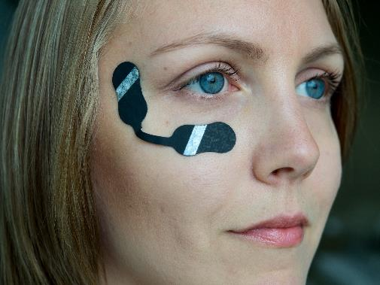


OE-A Competition 2024
Application Form
Image source: VTT & OE-A
OE-A
Frankfurt, Germany
www.oe-a.org
theresa.manns@oe-a.org
A working group within

Slide 2
Phase 1 Application Form: Introduction
Please fill in everything marked in yellow from slides 3 - 13
  Please list all project partners and the name of your project. Please be aware that only OE-A members will gain full visibility in all communication processes.
  Send your application form to theresa.manns@oe-a.org. Deadline: October 20, 2023
  Only fully completed application forms can be taken into consideration
  This presentation is about design, functionality and purpose of your demonstrators. Images, video and manual of use are to be submitted additionally. Deadline: December 15, 2023

Slide 3
Project Title
Company name
Please insert image/ drawing of your project here
Title, first name, last name of main contact
Company
City, Country
Company Website
Mail
Phone
Please insert
your logo here
Image source:

Slide 4
Contact Details
Cooperating Partner(s)
Please copy slide if you have more project partners!
If you are cooperating with an OE-A or non-OE-A member, please fill in the following data (please list all partners).
Title, first name, last name of main contact
Company
City, Country
Company Website
Mail
Phone
Logo

Slide 5
Category
Please highlight the category you are applying for:
Prototypes and New Products
Freestyle Demonstrator
Publicly Funded Project Demonstrator

Slide 6
Project Description Outline
Please describe your demo in detail – fill in on slide 7
  Purpose (what is the purpose / goal of the demo? Impact to society?)
  Key Features (what can your product / prototype do?)
How would you describe your demo in simple words? – fill in on slide 8
  What does the demo represent?
  Please explain in simple words (for John Doe and non-experts)
Functionality – fill in on slide 9
  Please describe how your demo works
Please describe the benefits of your demonstrator – fill in on slide 10
  What is the motivation behind your demonstrator?
  What problem does your project solve / what issue does it tackle?
  What are advantages of your demonstrator?

Slide 7
Project Description
Please add your project description here (Purpose, Key Features, Impact, …)

Slide 8
Project Description
Please explain your project in simple words (for John Doe and non- experts)

Slide 9
Functionality
Please explain how your demonstrator works

Slide 10
Benefits of your project
Please explain the benefits of your project here (Motivation, Advantages, …)

Slide 11
Target Industry
Please insert the target industry of your demonstrator here
For example: Automotive, Consumer Electronics, Healthcare, Internet of Things, Printing and Packaging, Smart Buildings

Slide 12
Category
Please highlight the organic and printed electronics components you are using:
Conductive path
Interconnection
OLED
OPV
Organic TFT / Printed TFT
Organic Semiconductor
Printed antenna
Printed battery
Printed capacitive switch
Printed dieelectric / insulator
Printed electrochromic display
Printed electrode
Printed electroluminescent display
Printed heater
Printed piezo elements
Printed sensor
Other, please specify …

Slide 13
Classical Components
Please insert all classical electronic components in your demonstrator

Slide 14
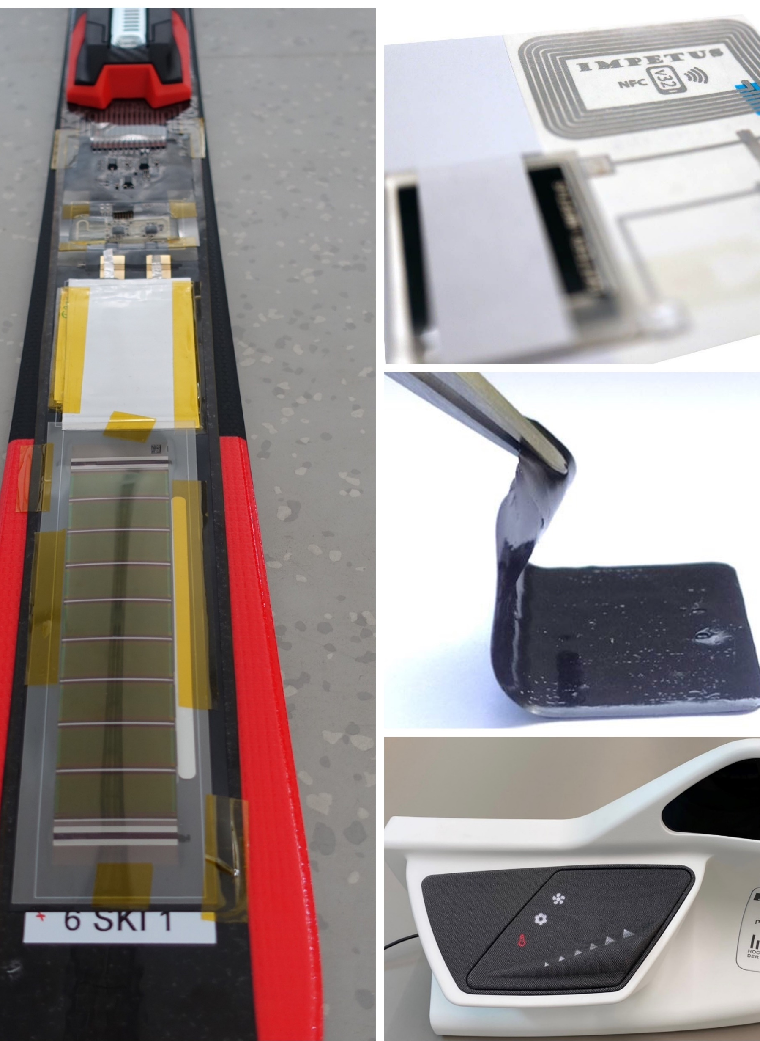
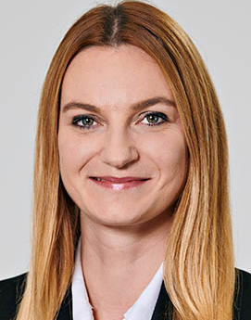



Contact
Theresa Manns
Assistant Press & PR
OE-A Competition
theresa.manns@oe-a.org
+49 69 6603 1194
OE-A – A working group within VDMA
www.linkedin.com/oe-a
@OEAonline
www.oe-a.org
Source: OE-A

